Slide 1











FIRI Simulator - PyFIInS
John Lightfoot (UKATC)
Colm Bracken (NUI Maynooth)
Roser Juanola-Parramon (UCL, NASA Goddard)
Gibion Makiwa (U.Lethbridge)

Slide 2




Requirements
Public code
Free, portable, no special hardware ➔ Python
Able to model the ‘strawman’ design.
2 flux collectors with 2m primary mirrors
Tethered with baselines up to 80m
Flexible – design / observing mode / target
Able to observe any target
Able to model physics and systematic effects

Slide 3
Design: User Interface
Excel ‘instrument; file describing instrument configuration / observation timeline
FITS format ‘target’ file with object to ‘observe’ – github CUBEFORMAT.com

Slide 4
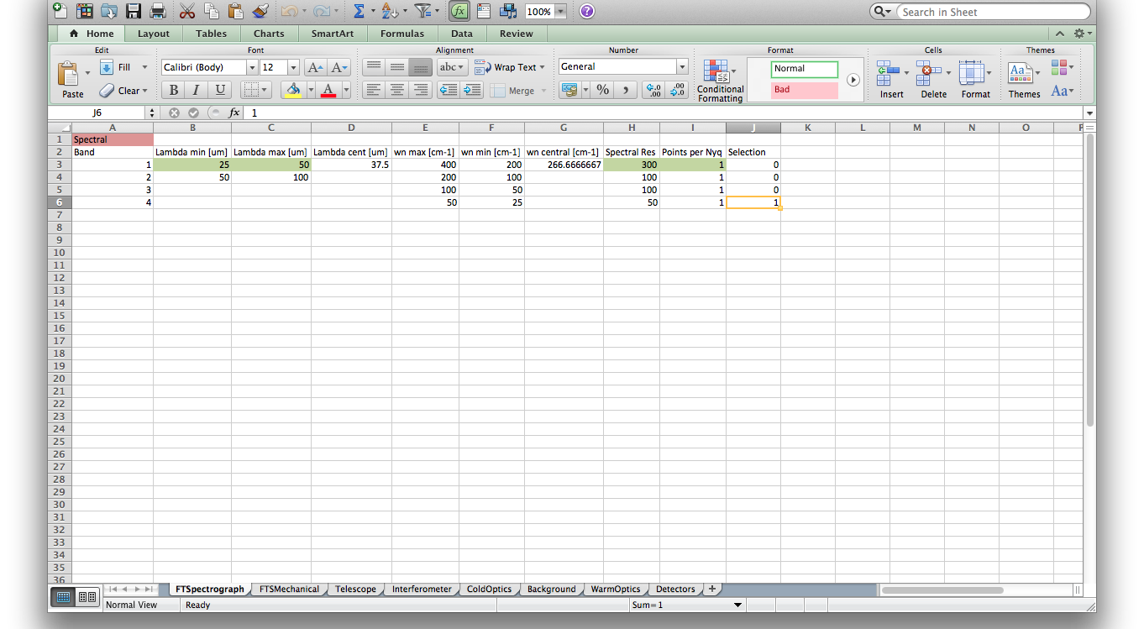
User Interface – the instrument file
FTSpectrograph

Slide 5
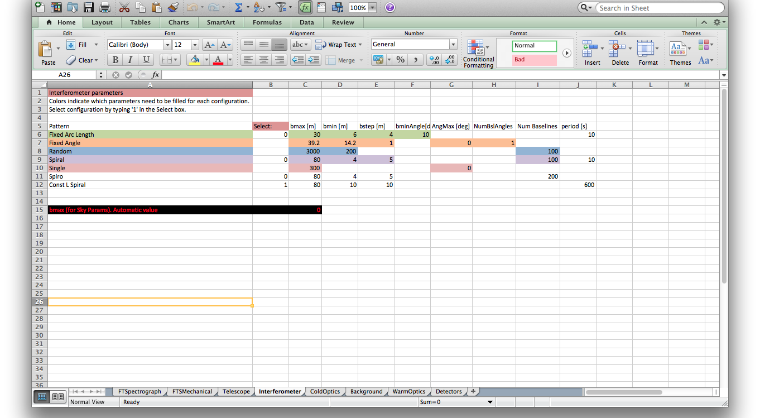
User Interface – the instrument file
Interferometer

Slide 6
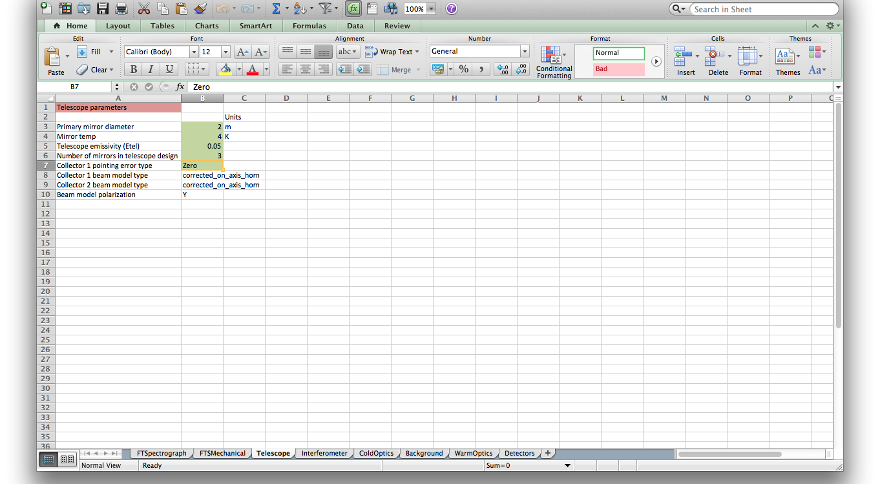
User Interface – the instrument file
Telescope

Slide 7
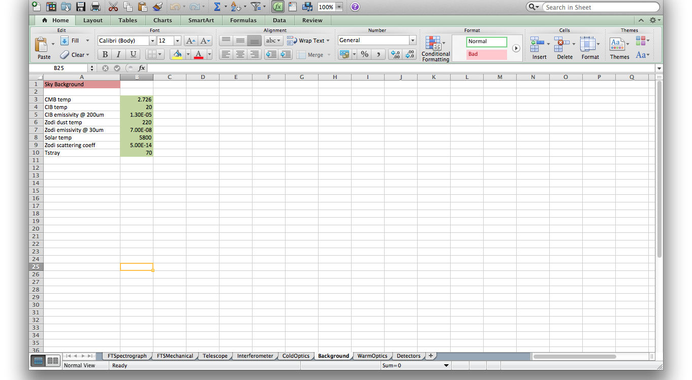
User Interface – the instrument file
Background

Slide 8
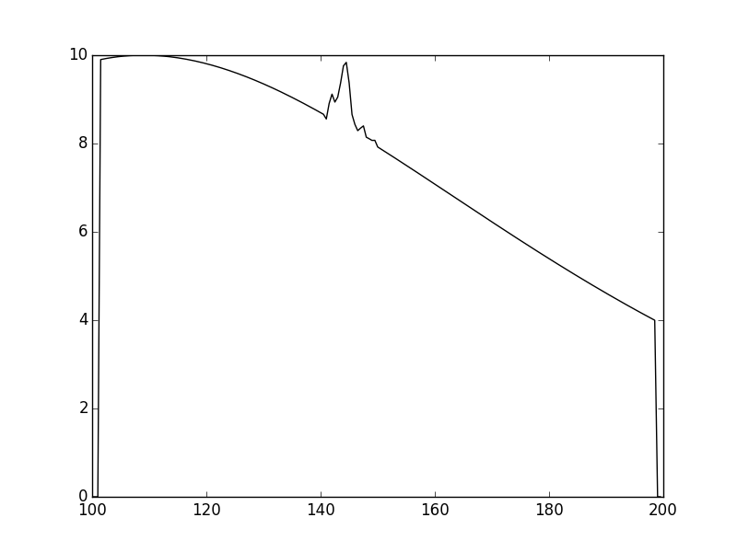
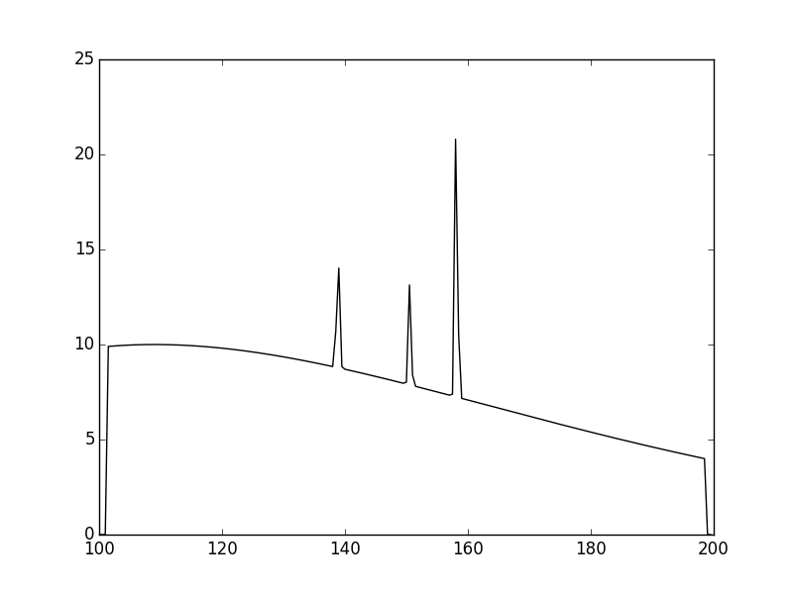
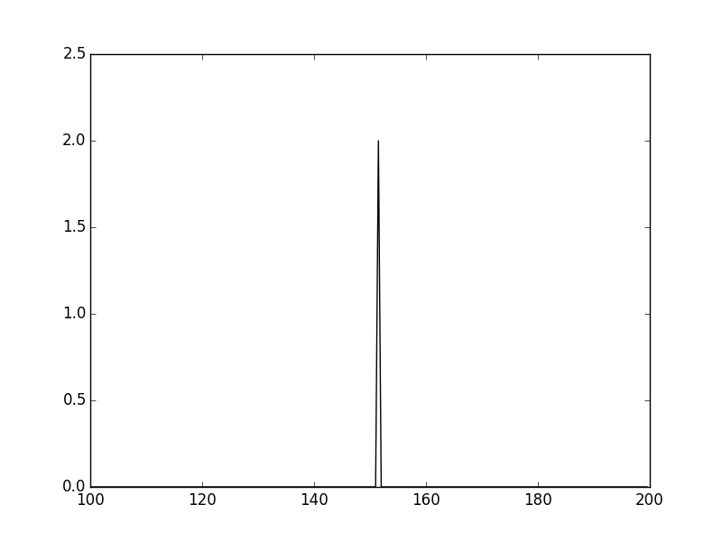
User Interface – the target file
FITS format described in CUBEFORMAT.md
Target ‘toolkit’:
Spectrum generation
T, β, peak flux, lines and features
Forsterite
Protostar
Comet
Image generation
From FITS
‘ring’, ‘thick disk’, ‘comet’
Spectrum + image = cube
Cube1 + cube2 +… = target_cube
T Tauri disk

Slide 9
The Calculation
Efficiency:
numpy and scipy for array calculations
Parallel Python (www.parallelpython.com) for parallelization
8GB laptop good for Band4 25-50cm⁻¹ (R = 50)
64GB desktop for Band2 100-200cm⁻¹ (R = 100)
Process:
PyFIInS target cube ➔ interferograms
PyDataProcessing interferograms ➔ dirty cube
Timings:
Band 4, 4 + 1 hours
Band 2, 8 + 2 hours

Slide 10
Physics and Systematic Errors
Physics:
Thermal noise from instrument elements
Photon noise from background (CMB, CIB, Zodiacal light)
Cosmic ray strikes (from SPIRE)
Systematics:
Primary beams from realistic optics
Temperature fluctuations
Collector pointing errors
Baseline pointing errors
FTS beam combiner mirror errors (from SPIRE)
Continuous baseline movement
Detector time constant

Slide 11
Results
HTML weblog
Interferograms / dirty cube in FITS format

Slide 12
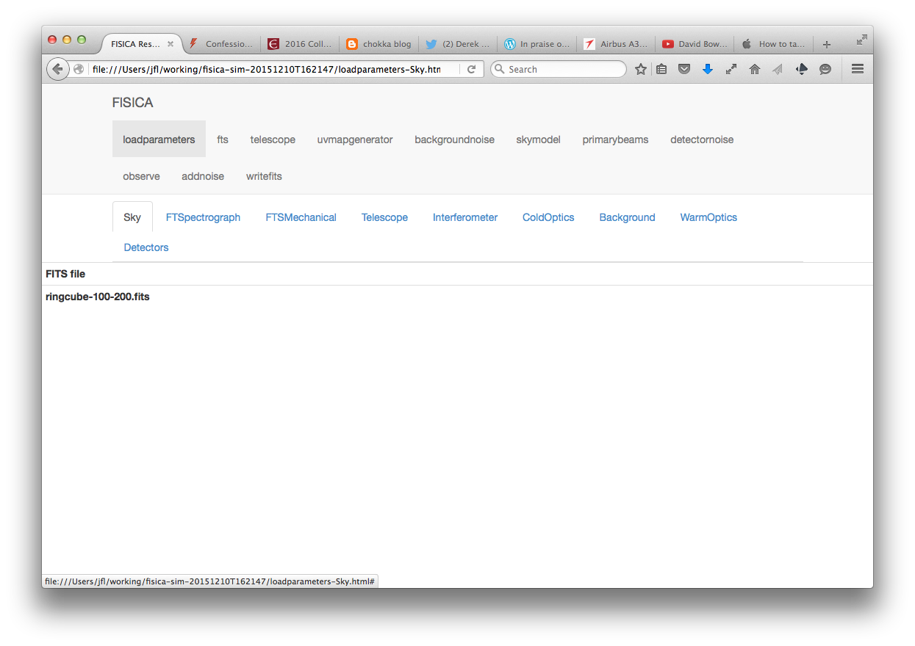
Results – PyFIInS weblog 1

Slide 13
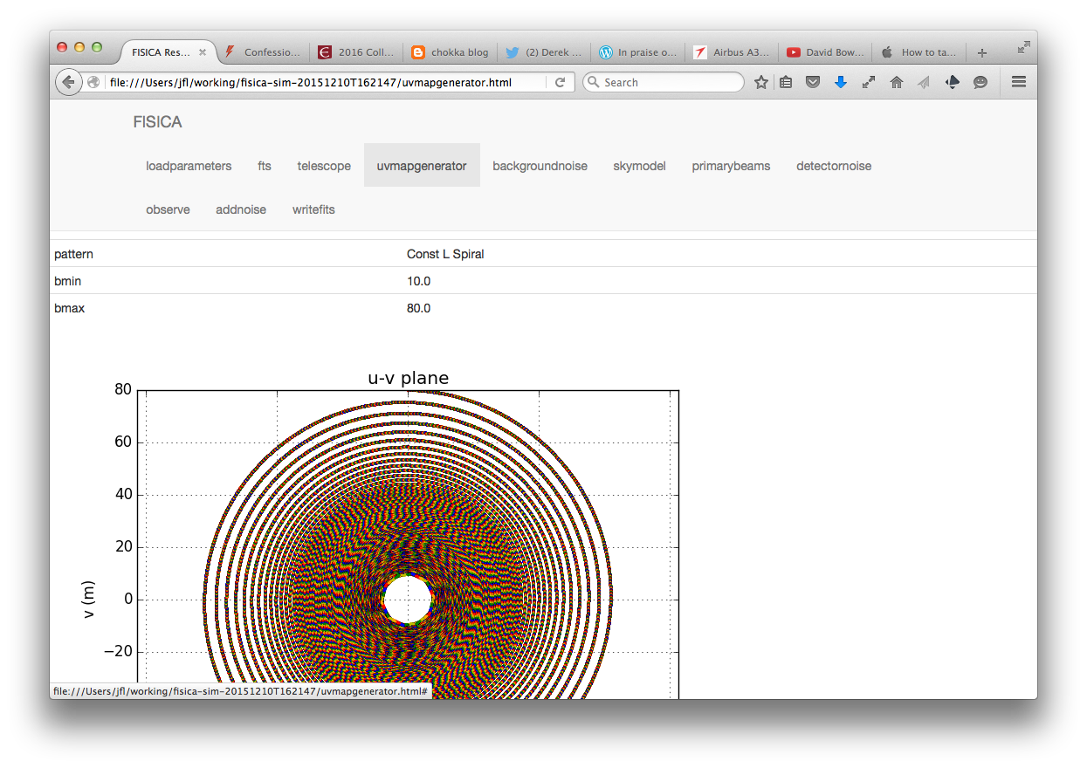
Results – PyFIInS weblog 2

Slide 14
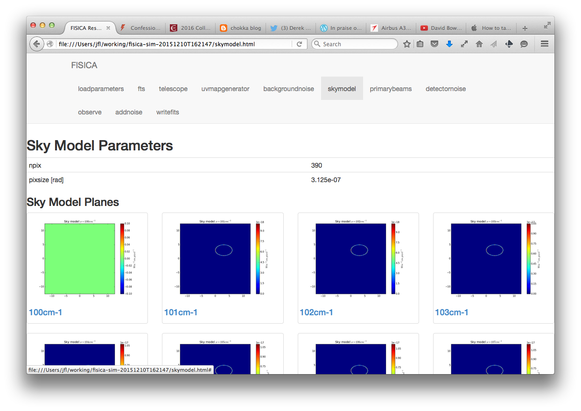
Results – PyFIInS weblog 3

Slide 15
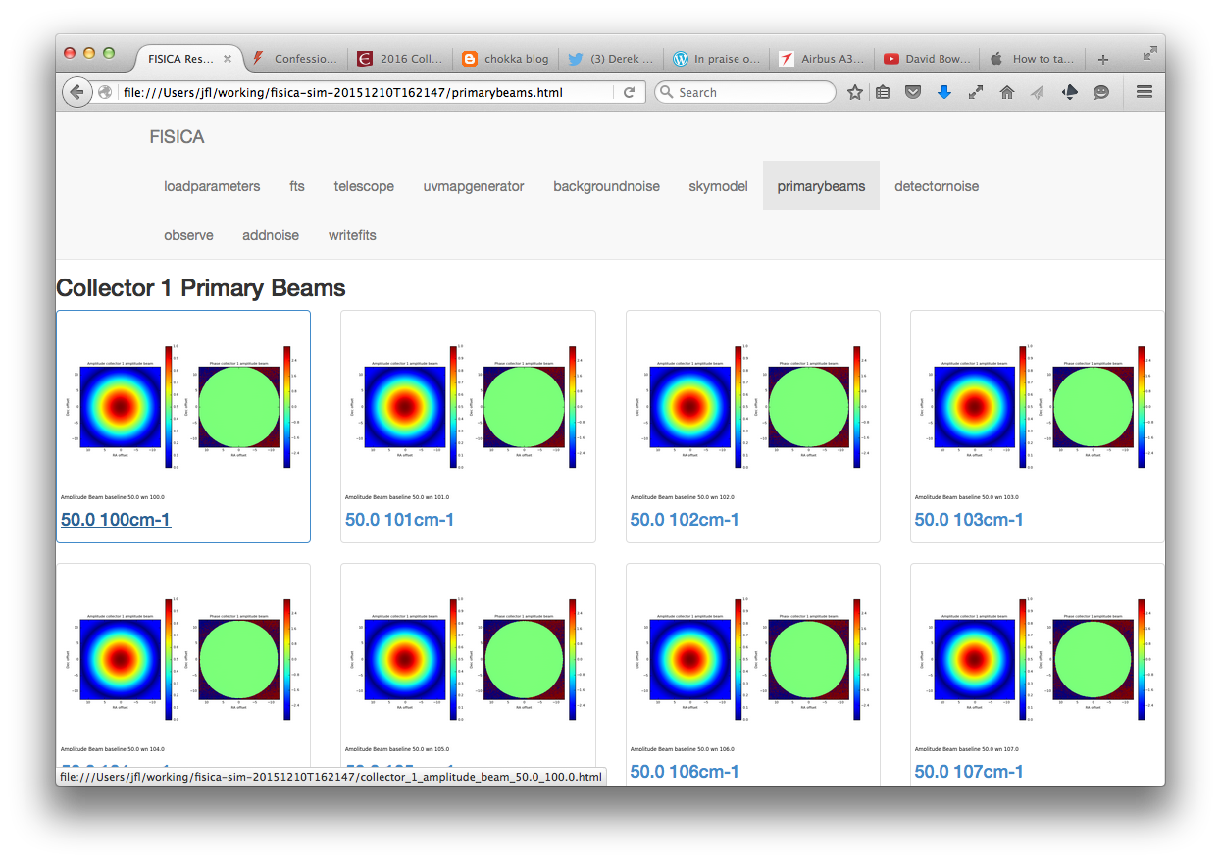
Results – PyFIInS weblog 4

Slide 16
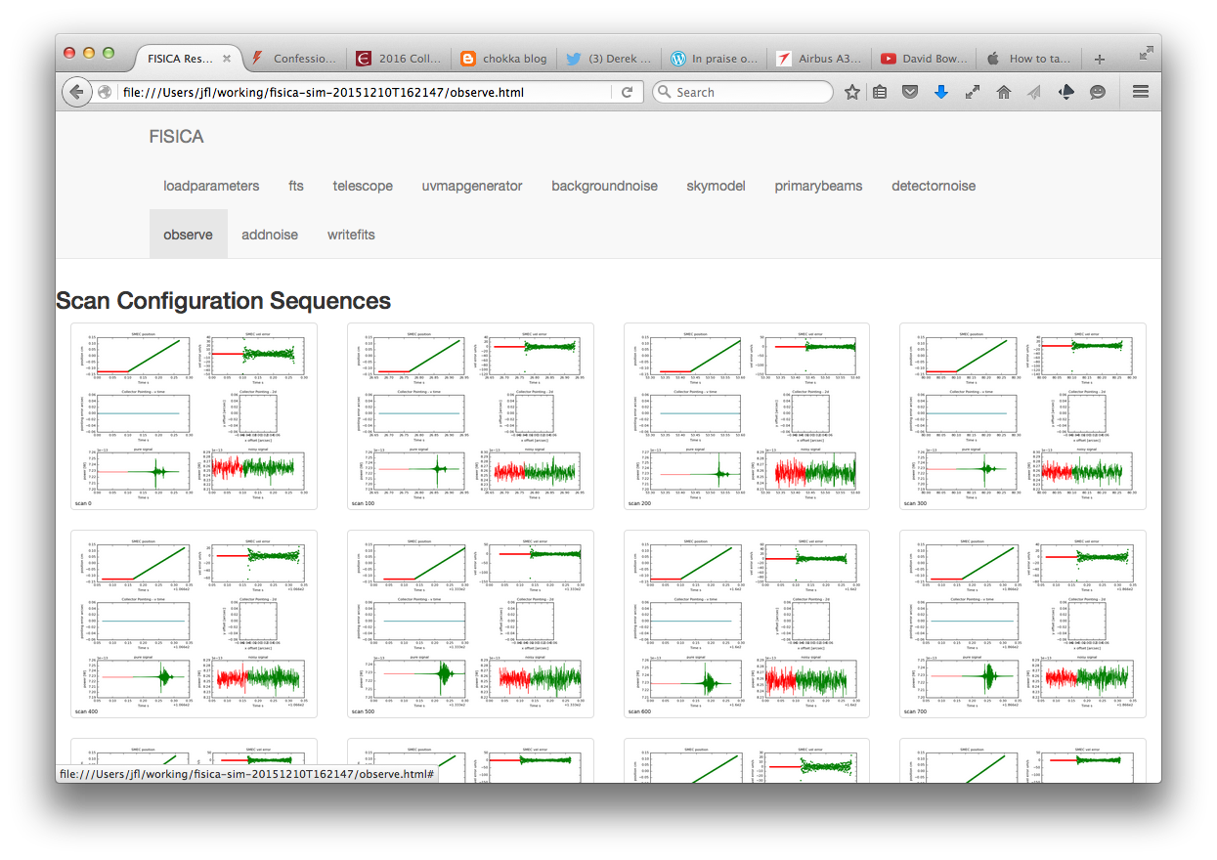
Results – PyFIInS weblog 5

Slide 17
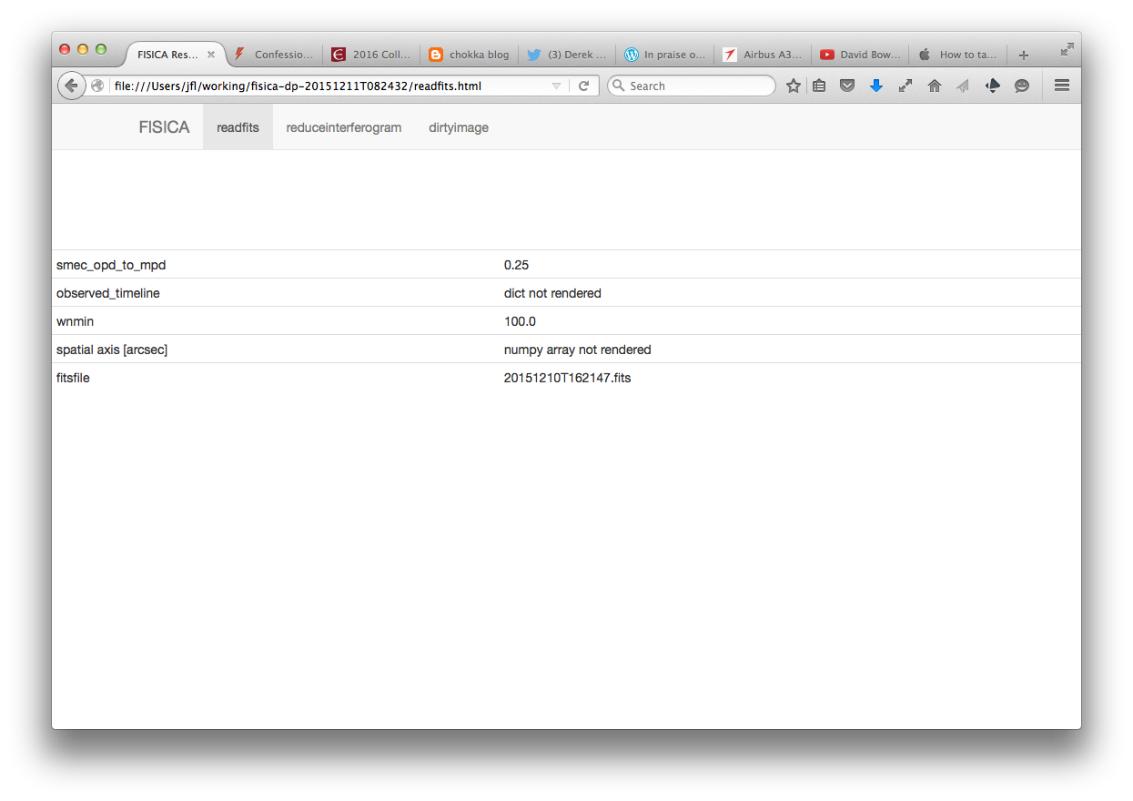
Results – PyDataProcessing weblog 1

Slide 18
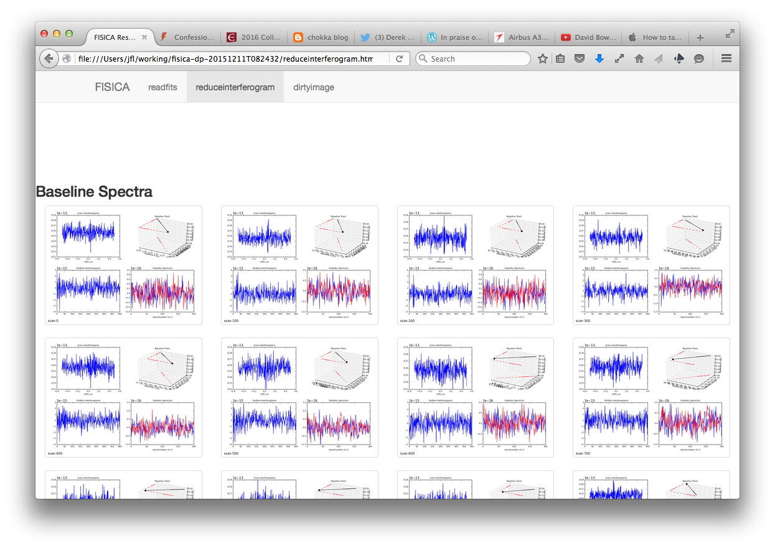
Results – PyDataProcessing weblog 2

Slide 19
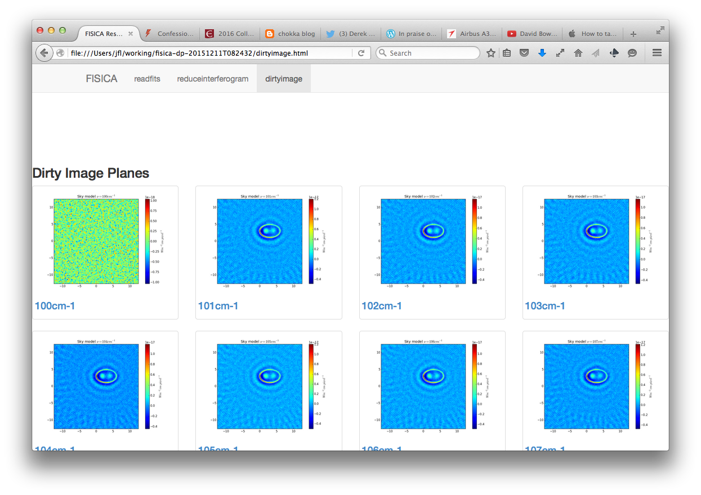
Results – PyDataProcessing weblog 3

Slide 20
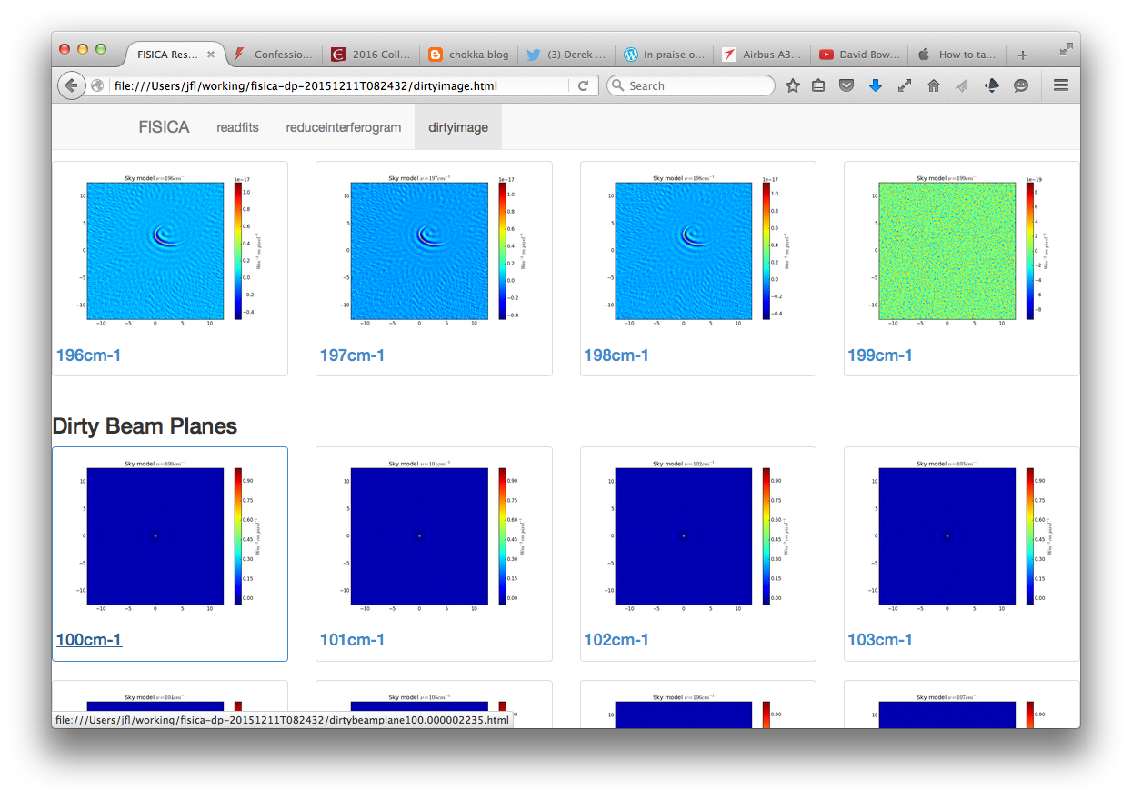
Results – PyDataProcessing weblog 4

Slide 21
Installation
Code at www.github.com/handofkwll/fisica
Instructions for Linux/OSX in README.md
‘instrument’ file for strawman instrument - Band 4
‘target’ file with circumstellar ring - Band 4
Cookbook – pre-stellar cores example

Slide 22
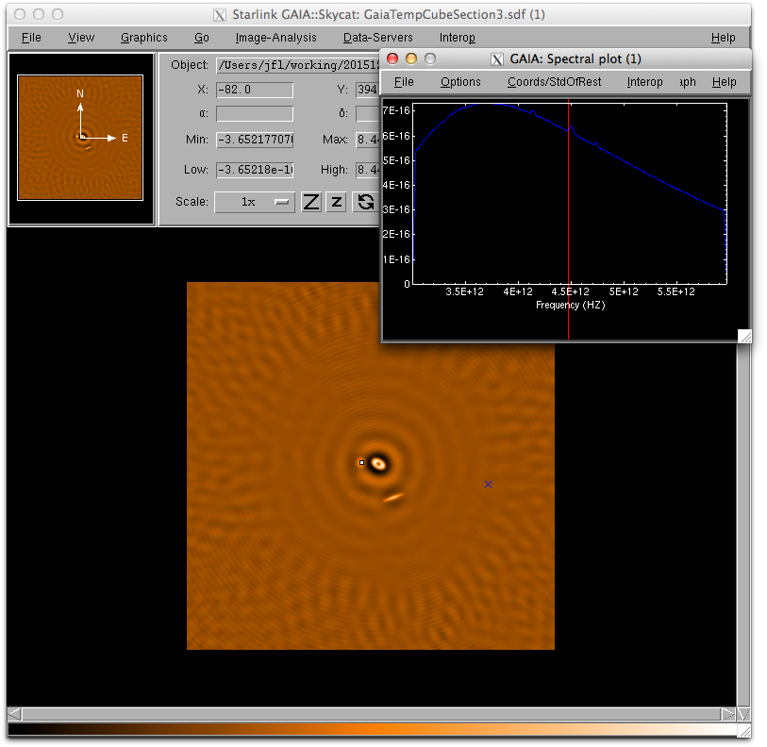
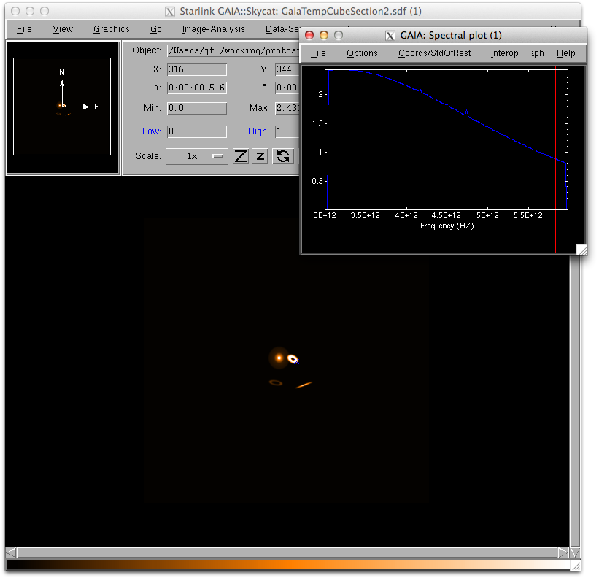
Examples 1 – Prestellar cores

Slide 23
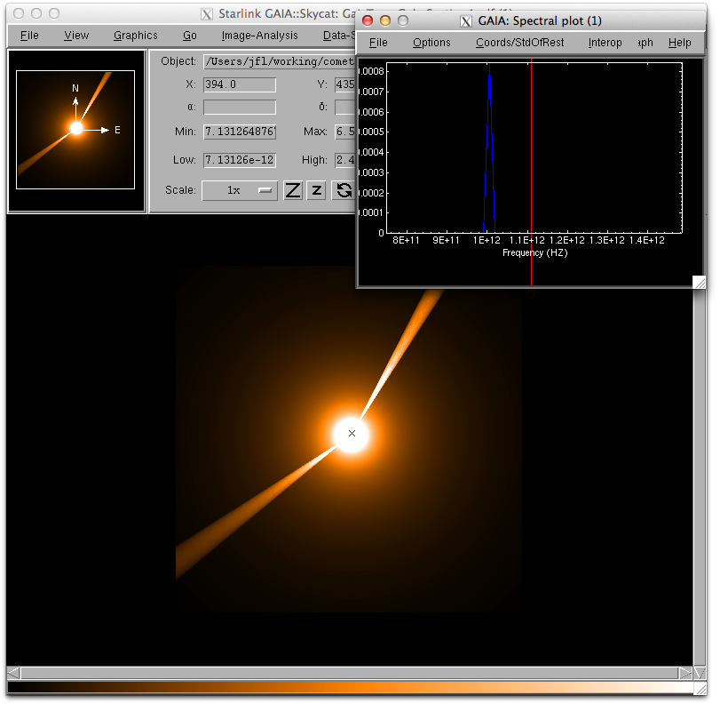
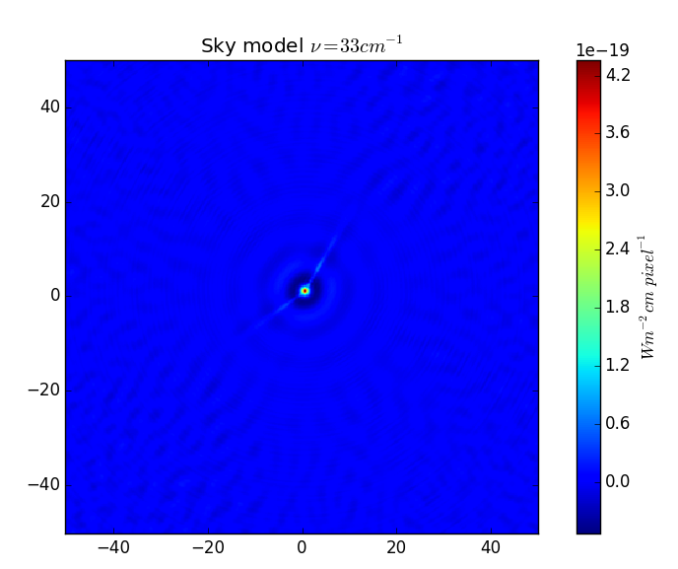
Examples 2 – Comet

Slide 24
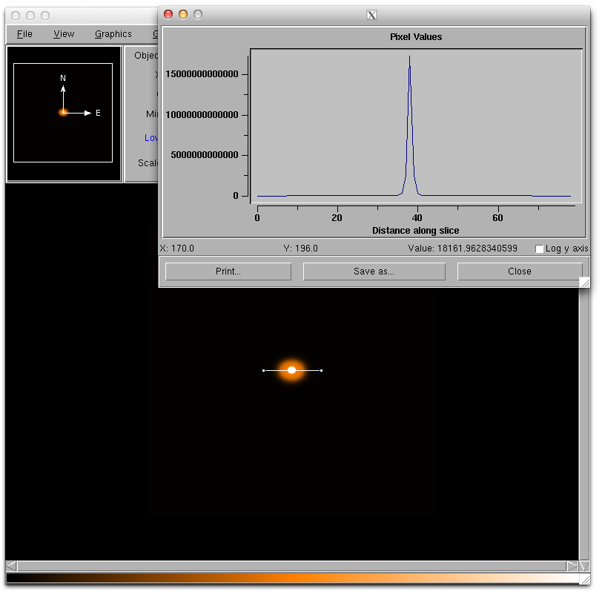
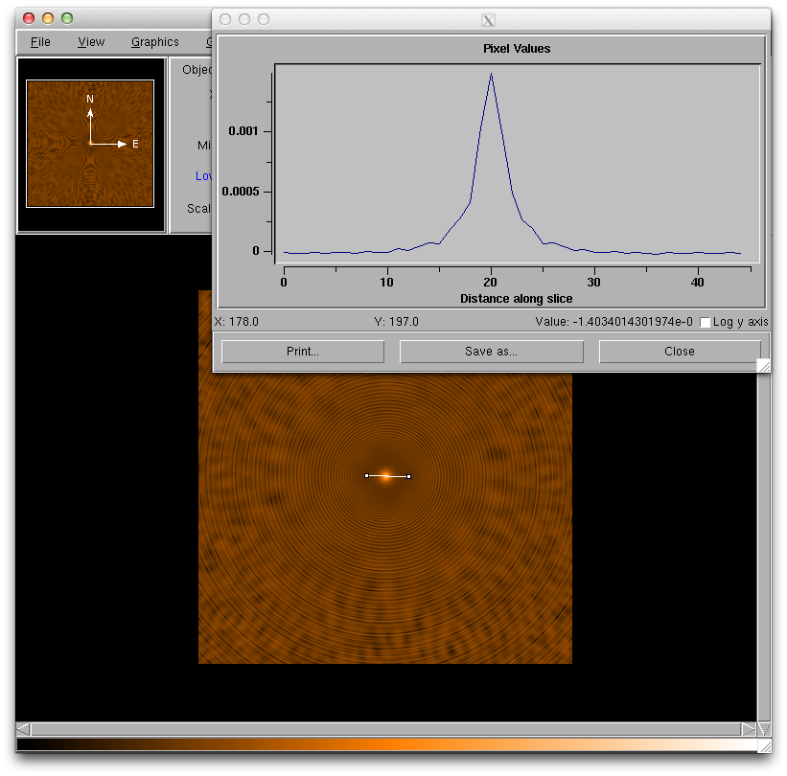
Examples 3 – T Tauri disk (P. Woitke, St.Andrews)

